Slide 1

Understanding Cryptography by Christof Paar and Jan Pelzl www.crypto-textbook.com Chapter 4 – The Advanced Encryption Standard (AES)
M Rahaman, PhD
Professor
Department of Computer Science and Engineering
Jahangirnagar University
Savar, Dhaka, Bangladesh

Slide 2
Content of this Chapter
Overview of the AES algorithm
Some Mathematics: A Brief Introduction to Galois Fields
Internal structure of AES
Byte Substitution layer
Diffusion layer
Key Addition layer
Key schedule
Decryption
Practical issues

Slide 3
Classification of DES in the Field of Cryptology
Cryptology
Cryptography
Cryptanalysis
Symmetric Ciphers
Asymmetric Ciphers
Protocols
Block Ciphers
Stream Ciphers
You are here!

Slide 4
Introduction
The Advanced Encryption Standard (AES) is the most widely used symmetric cipher today.
AES block cipher is also mandatory in several industry standards and is used in many commercial systems.
AES are used the Internet security standard IPsec, TLS, the Wi-Fi encryption standard IEEE 802.11i, the secure shell network protocol SSH (Secure Shell), the Internet phone Skype and numerous security products around the world.
To date, there are no attacks better than brute-force known against AES

Slide 5
Some Basic Facts
The algorithm for AES was chosen by the US National Institute of Standards and Technology (NIST) in a multi-year selection process
The requirements for all AES candidate submissions were:
Block cipher with 128-bit block size
Three supported key lengths: 128, 192 and 256 bit
Security relative to other submitted algorithms
Efficiency in software and hardware
Notes:
In 1999 the US National Institute of Standards and Technology NIST) indicated that DES should only be used for legacy systems and instead triple DES (3DES) should be used. Even though 3DES resists brute-force( attacks with today’s technology, there are several problems with it. First, it is not very efficient with regard to software implementations. DES is already not particularly well suited for software and 3DES is three times slower than DES. Another disadvantage is the relatively short block size of 64 bits, which is a drawback in certain applications, e.g., if one wants to built a hash function from a block cipher (cf. Sect. 11.3.2). Finally, if one is worried about attacks with quantum computers, which might become reality in a few decades, key lengths on the order of 256 bits are desirable. All these consideration led NIST to the conclusion that an entirely new block cipher was needed as a replacement for DES. In 1997 NIST called for proposals for a new Advanced Encryption Standard (AES). Unlike the DES development, the selection of the algorithm for AES was an open process administered by NIST. In three subsequent AES evaluation rounds, NIST and the international scientific community discussed the advantages and disadvantages of the submitted ciphers and narrowed down the number of potential candidates. In 2001, NIST declared the block cipher Rijndael as the new AES and published it as a final standard (FIPS PUB 197). Rijndael was designed by two young Belgian cryptographer

Slide 6
Chronology of the AES Selection
The need for a new block cipher announced by NIST in January, 1997
15 candidates algorithms accepted in August, 1998
5 finalists announced in August, 1999:
Mars – IBM Corporation
RC6 – RSA Laboratories
Rijndael – J. Daemen & V. Rijmen
Serpent – Eli Biham et al.
Twofish – B. Schneier et al.
In October 2000, Rijndael was chosen as the AES
AES was formally approved as a US federal standard in November 2001
Notes:
The invitation for submitting suitable algorithms and the subsequent evaluation of the successor of DES was a public process. A compact chronology of the AES selection process is given here: The need for a new block cipher was announced on January 2, 1997, by NIST. A formal call for AES was announced on September 12, 1997. Fifteen candidate algorithms were submitted by researchers from several countries by August 20, 1998. On August 9, 1999, five finalist algorithms were announced: Mars by IBM Corporation RC6 by RSA Laboratories Rijndael, by Joan Daemen and Vincent Rijmen Serpent, by Ross Anderson, Eli Biham and Lars Knudsen Twofish, by Bruce Schneier, John Kelsey, Doug Whiting, David Wagner, Chris Hall and Niels Ferguson
On October 2, 2000, NIST announced that it had chosen Rijndael as the AES. On November 26, 2001, AES was formally approved as a US federal standard. It is expected that AES will be the dominant symmetric-key algorithm for many commercial applications for the next few decades. It is also remarkable that in 2003 the US National Security Agency (NSA) announced that it allows AES to encrypt classified documents up to the level SECRET for all key lengths, and up to the TOP SECRET level for key lengths of either 192 or 256 bits. Prior to that date, only non-public algorithms had been used for the encryption of classified documents.

Slide 7
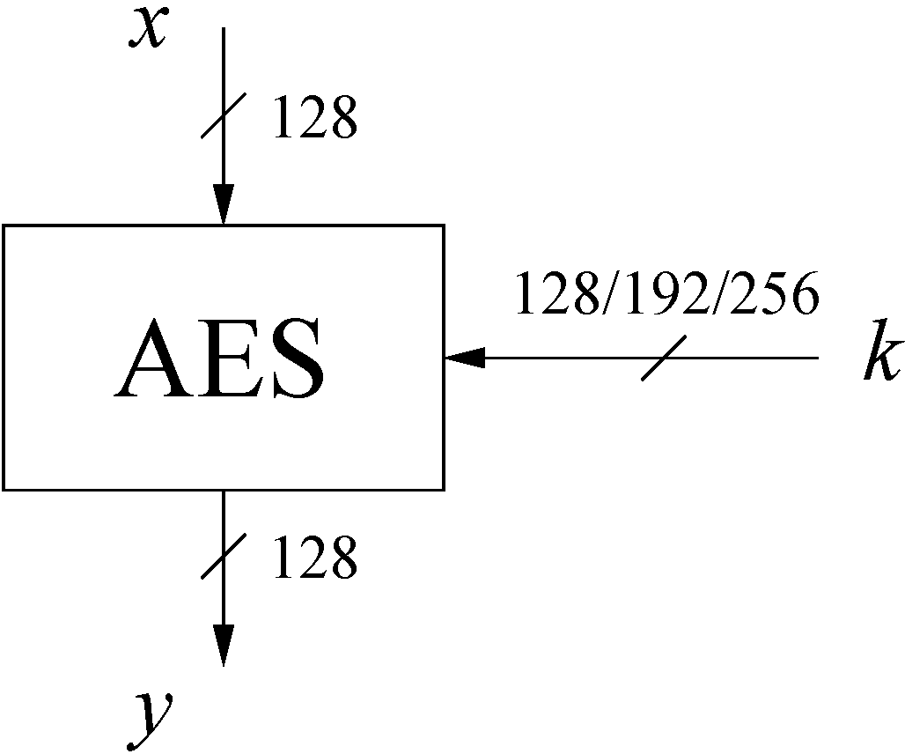
AES: Overview
The number of rounds depends on the chosen key length:
Key length (bits) | Number of rounds
128 | 10
192 | 12
256 | 14
Notes:
The AES cipher is almost identical to the block cipher Rijndael. The Rijndael block and key size vary between 128, 192 and 256 bits. However, the AES standard only calls for a block size of 128 bits. Hence, only Rijndael with a block length of 128 bits is known as the AES algorithm. In the remainder of this chapter, we only discuss the standard version of Rijndael with a block length of 128 bits.
As mentioned previously, three key lengths must be supported by Rijndael as this was an NIST design requirement. The number of internal rounds of the cipher is a function of the key length according to Table 4.1.
In contrast to DES, AES does not have a Feistel structure. Feistel networks do not encrypt an entire block per iteration, e.g., in DES, 64/2 = 32 bits are encrypted in one round. AES, on the other hand, encrypts all 128 bits in one iteration. This is one reason why it has a comparably small number of rounds.

Slide 8
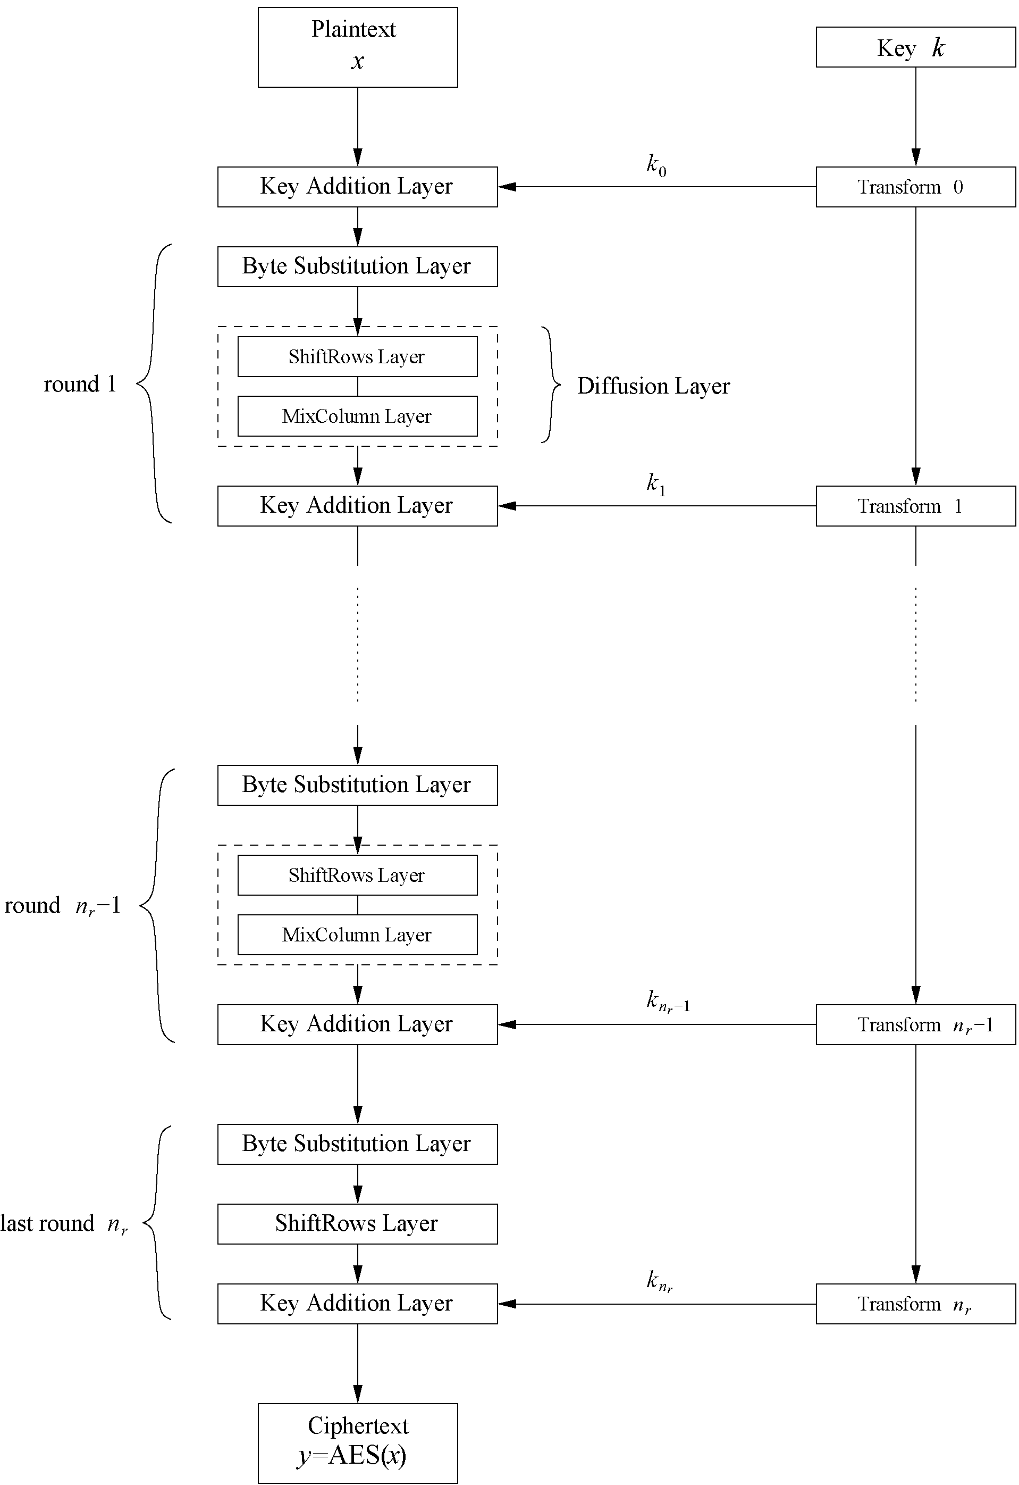
AES: Overview
AES consists of so-called layers.
Each layer manipulates all 128 bits of the data path. The data path is also referred to as the state of the algorithm.
There are only three different types of layers.
Each round, with the exception of the first, consists of all three layers as shown
Here the plaintext is denoted as x, the ciphertext as y and the number of rounds as n_{r}.
Moreover, the last round n_{r} does not make use of the MixColumn transformation, which makes the encryption and decryption scheme symmetric.
Iterated cipher with 10/12/14 rounds
Each round consists of “Layers”
Notes:
AES consists of so-called layers. Each layer manipulates all 128 bits of the data path. The data path is also referred to as the state of the algorithm. There are only three different types of layers. Each round, with the exception of the first, consists of all three layers as shown in Fig. 4.2: the plaintext is denoted as x, the ciphertext as y and the number of rounds as nr. Moreover, the last round n_{r} does not make use of the MixColumn transformation, which makes the encryption and decryption scheme symmetric. We continue with a brief description of the layers: Key Addition layer A 128-bit round key, or subkey, which has been derived from the main key in the key schedule, is XORed to the state. Byte Substitution layer (S-Box) Each element of the state is nonlinearly transformed using lookup tables with special mathematical properties. This introduces confusion to the data, i.e., it assures that changes in individual state bits propagate quickly across the data path. Diffusion layer It provides diffusion over all state bits. It consists of two sublayers, both of which perform linear operations: The ShiftRows layer permutes the data on a byte level. The MixColumn layer is a matrix operation which combines (mixes) blocks of four bytes. Similar to DES, the key schedule computes round keys, or subkeys,(k0,k1,...,knr) from the original AES key. Before we describe the internal functions of the layers in Sect. 4.4, we have to introduce a new mathematical concept, namely Galois fields. Galois field computations are needed for all operations within the AES layers.

Slide 9
AES: Overview (Cont..)
Key Addition layer:
A 128-bit round key, or subkey, which has been derived from the main key in the key schedule, is XORed to the state.
Byte Substitution layer (S-Box):
Each element of the state is nonlinearly transformed using lookup tables with special mathematical properties. This introduces confusion to the data, i.e., it assures that changes in individual state bits propagate quickly across the data path.
Diffusion layer
It provides diffusion over all state bits. It consists of two sublayers, both of which perform linear operations:
The ShiftRows layer permutes the data on a byte level.
The MixColumn layer is a matrix operation which combines (mixes) blocks of four bytes.
Similar to DES, the key schedule computes round keys, or subkeys,(k₀,k₁,...,k_{nr}) from the original AES key.

Slide 10
Content of this Chapter
Overview of the AES algorithm
Some Mathematics: A Brief Introduction to Galois Fields
Internal structure of AES
Byte Substitution layer
Diffusion layer
Key Addition layer
Key schedule
Decryption
Practical issues

Slide 11
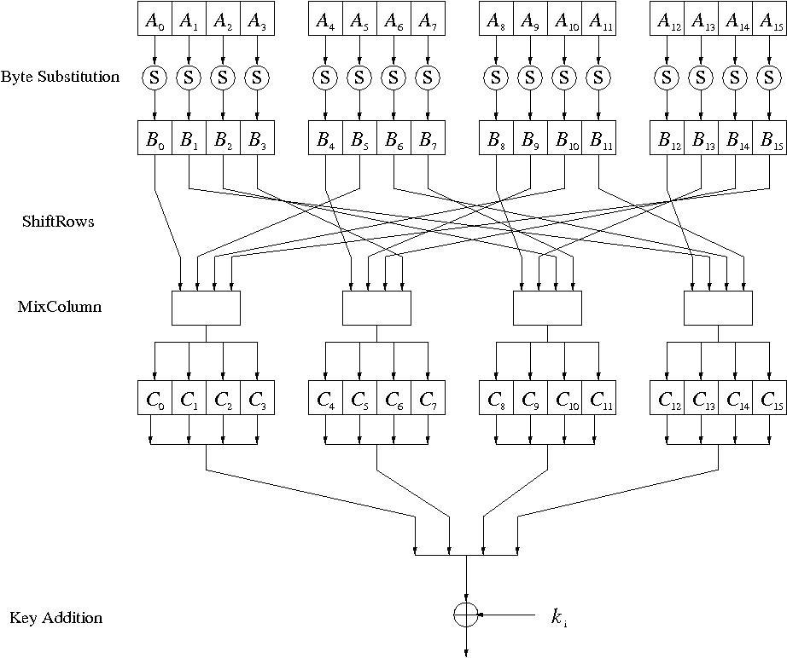
Internal Structure of AES
Round function for rounds 1,2,…,n_{r-1}:
Note: In the last round, the MixColumn transformation is omitted
Notes:
In the following, we examine the internal structure of AES. Figure 4.3 shows the graph of a single AES round. The 16-byte input A0, . . . ,A15 is fed byte-wise into the S-Box. The 16-byte output B0, . . . ,B15 is permuted byte-wise in the ShiftRows layer and mixed by the MixColumn transformation c(x). Finally, the 128-bit subkey ki is XORed with the intermediate result. We note that AES is a byte-oriented cipher

Slide 12
Internal Structure of AES
AES is a byte-oriented cipher
In order to understand how the data moves through AES,
We first imagine that the state A (i.e., the 128-bit data path) consisting of 16 bytes A0,A1,...,A15 is arranged in a four-by-four byte matrix
The state A (i.e., the 128-bit data path) can be arranged in a 4x4 matrix:
with A₀,…, A₁₅ denoting the 16-byte input of AES
A₀ | A₄ | A₈ | A₁₂
A₁ | A₅ | A₉ | A₁₃
A₂ | A₆ | A₁₀ | A₁₄
A₃ | A₇ | A₁₁ | A₁₅
Notes:
In order to understand how the data moves through AES, we first imagine that the state A (i.e., the 128-bit data path) consisting of 16 bytes A0,A1, . . . ,A15 is arranged in a four-by-four byte matrix:

Slide 13

Byte Substitution Layer
The Byte Substitution layer consists of 16 S-Boxes with the following properties:
The S-Boxes are
Identical to each other
the only nonlinear elements of AES, i.e., ByteSub(A_{i}) + ByteSub(A_{j}) ≠ ByteSub(A_{i} + A_{j}), for i,j = 0,…,15
bijective, i.e., there exists a one-to-one mapping of input and output bytes ⇒ S-Box can be uniquely reversed
In software implementations, the S-Box is usually realized as a lookup table
Notes:
As shown in Fig. 4.3, the first layer in each round is the Byte Substitution layer. The Byte Substitution layer can be viewed as a row of 16 parallel S-Boxes, each with 8 input and output bits. Note that all 16 S-Boxes are identical, unlike DES where
eight different S-Boxes are used. In the layer, each state byte Ai is replaced, i.e., substituted, by another byte Bi:
S(Ai) = Bi.

Slide 14
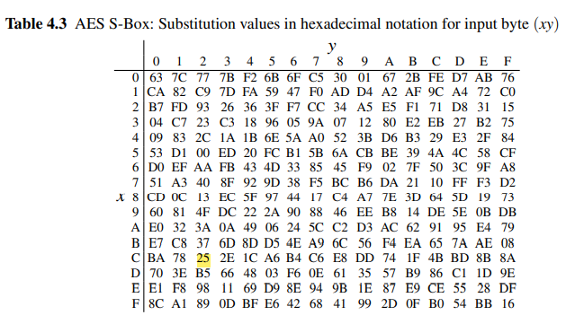
Lookup Table

Slide 15

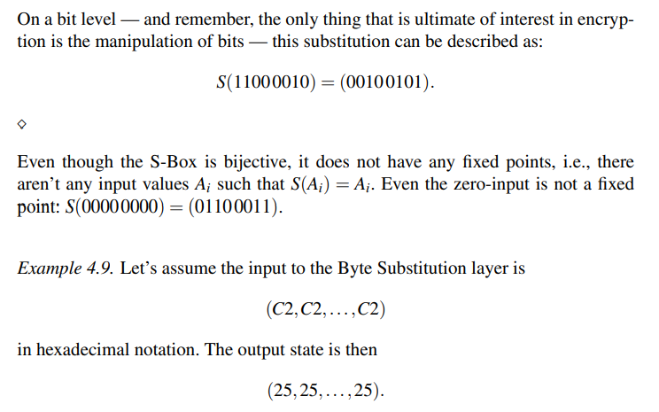
Example Let’s assume the input byte to the S-Box is A_{i} = (C2)_{hex}, then the substituted value is

Slide 16
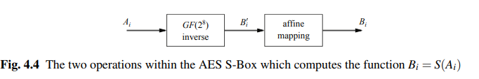
Mathematical description of the S-Box
S-Boxes have a strong algebraic structure. An AES S-Box can be viewed as a twostep mathematical transformation
First part
It is Galois field inversion
For each input element A_{i}, the inverse is computed: B_{i} = A_{i}⁻¹ , where both A_{i} and B_{i} are considered elements in the field GF(2⁸) with the fixed irreducible polynomial P(x) = x⁸ + x⁴ + x³ + x + 1. A lookup table with all inverses is shown in Table 4.2

Slide 17
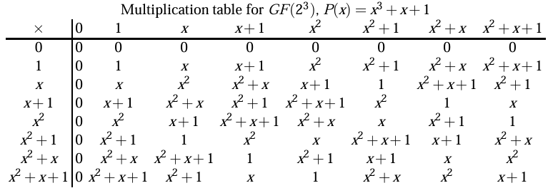
Generate the multiplication table for the extension field GF(2³) for the case that the irreducible polynomial is P(x)=x³+x+1. The multiplication table is in this case a 8×8 table. (Remark: You can do this manually or write a program for it.

Slide 18
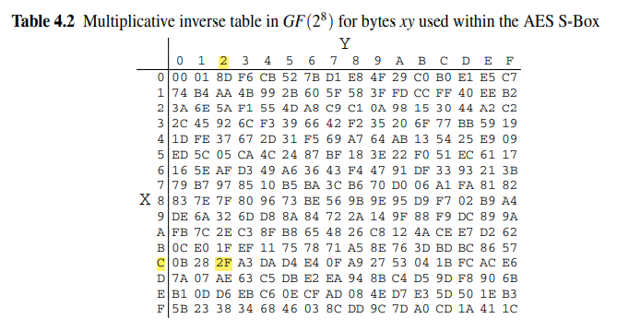
Multiplicative inverse table in GF(2⁸) for bytes xy used within the AES S-Box

Slide 19
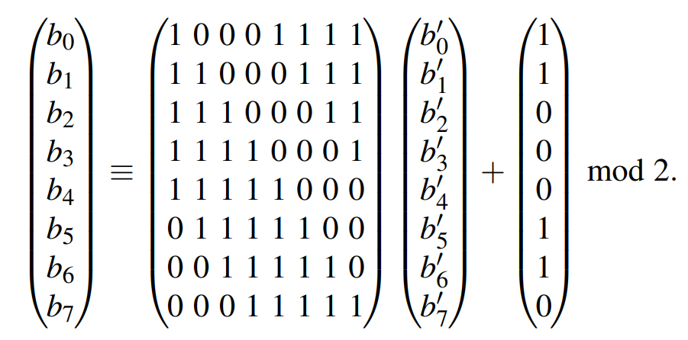
Mathematical description of the S-Box
In the second part of the substitution, each byte B’ is multiplied by a constant bit matrix followed by the addition of a constant 8-bit vector. The operation is described by-
Note that B’ = (b₇,...,b₀) is the bitwise vector representation of B’_{i} (x) = A⁻¹_{i}(x). This second step is referred to as affine mapping. Let’s look at an example of how the S-Box computations work

Slide 20

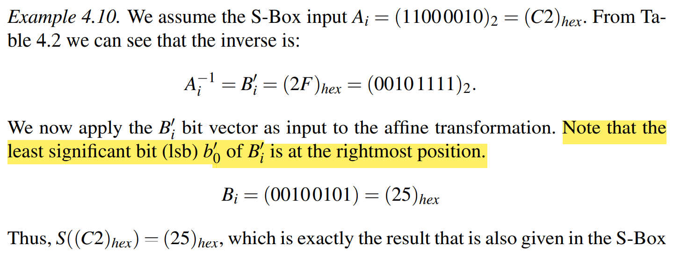
Example

Slide 21
Advantages
The advantage of using inversion in GF(2⁸) as the core function of the Byte Substitution layer is that
It provides a high degree of nonlinearity, which in turn provides optimum protection against some of the strongest known analytical attacks.
The affine step “destroys” the algebraic structure of the Galois field, which in turn is needed to prevent attacks that would exploit the finite field inversion

Slide 22
Diffusion Layer
The Diffusion layer has two transformation
Provides diffusion over all input state bits
Consists of two sublayers:
ShiftRows Sublayer: Permutation of the data on a byte level
MixColumn Sublayer: Matrix operation which combines (“mixes”) blocks of four bytes
performs a linear operation on state matrices A, B, i.e., DIFF(A) + DIFF(B) = DIFF(A + B)
Notes:
In AES, the Diffusion layer consists of two sublayers, the ShiftRows transformation and the MixColumn transformation. We recall that diffusion is the spreading of the influence of individual bits over the entire state. Unlike the nonlinear S-Box, the diffusion layer performs a linear operation on state matrices A,B, i.e., DIFF(A)+ DIFF(B) = DIFF(A+B)

Slide 23
ShiftRows Sublayer
Rows of the state matrix are shifted cyclically:
Input matrix
Output matrix
B₀ | B₄ | B₈ | B₁₂
B₁ | B₅ | B₉ | B₁₃
B₂ | B₆ | B₁₀ | B₁₄
B₃ | B₇ | B₁₁ | B₁₅
B₀ | B₄ | B₈ | B₁₂
B₅ | B₉ | B₁₃ | B₁
B₁₀ | B₁₄ | B₂ | B₆
B₁₅ | B₃ | B₇ | B₁₁
no shift
← one position left shift
← two positions left shift
← three positions left shift
Notes:
The ShiftRows transformation cyclically shifts the second row of the state matrix by three bytes to the right, the third row by two bytes to the right and the fourth row by one byte to the right. The first row is not changed by the ShiftRows transformation. The purpose of the ShiftRows transformation is to increase the diffusion properties of AES. If the input of the ShiftRows sublayer is given as a state matrix B = (B0,B1,...,B15):

Slide 24
MixColumn Sublayer
Linear transformation which mixes each column of the state matrix
Each 4-byte column is considered as a vector and multiplied by a fixed 4x4 matrix, e.g.,
where 01, 02 and 03 are given in hexadecimal notation
All arithmetic is done in the Galois field GF(2⁸)
Constant matrix
Notes:
The MixColumn step is a linear transformation which mixes each column of the state matrix. Since every input byte influences four output bytes, the MixColumn operation is the major diffusion element in AES. The combination of the ShiftRows and MixColumn layer makes it possible that after only three rounds every byte of the state matrix depends on all 16 plaintext bytes. In the following, we denote the 16-byte input state by B and the 16-byte output state by C: MixColumn(B) = C, where B is the state after the ShiftRows operation as given in Expression (4.1).
Now, each 4-byte column is considered as a vector and multiplied by a fixed 4 × 4 matrix. The matrix contains constant entries. Multiplication and addition of the coefficients is done in GF(2⁸). As an example, we show how the first four output bytes are computed

Slide 25
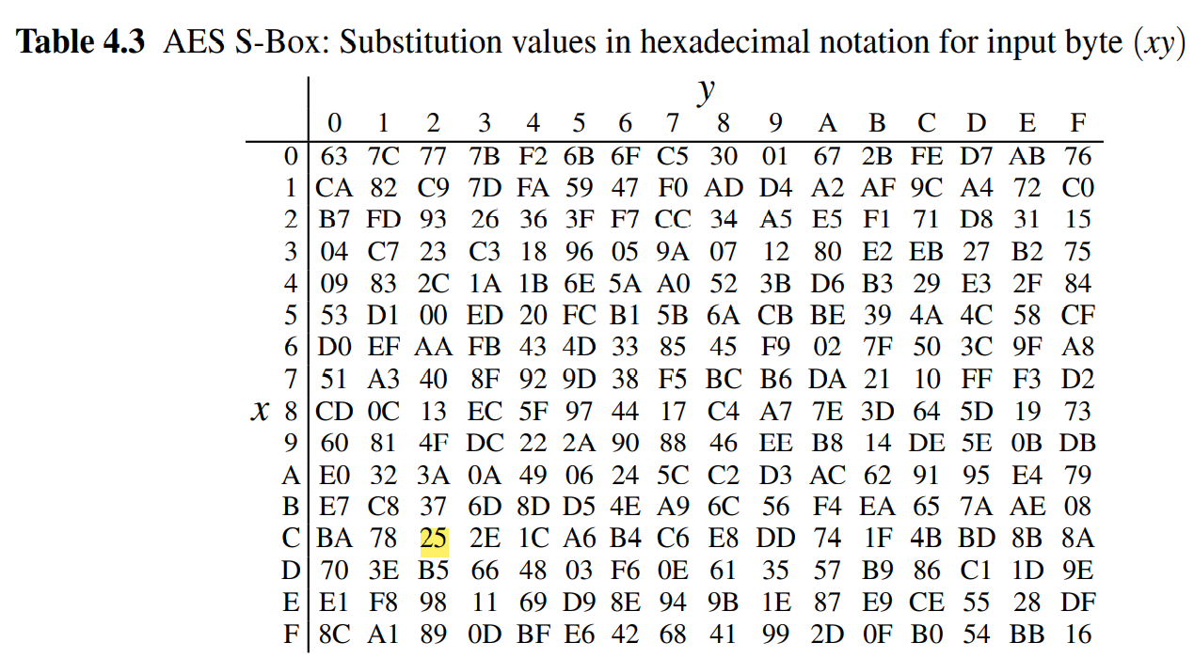
Example: Let’s assume the input A=(C2,C2,...,C2) find the
So the input to the Byte Substitution layer is A=(C2,C2,...,C2)
The output state is then B= (25,25,...,25) From Table 4.3

Slide 26
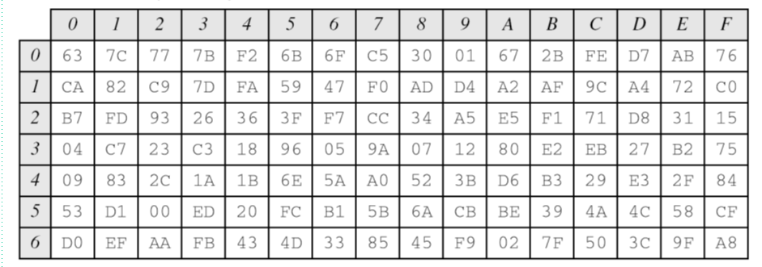
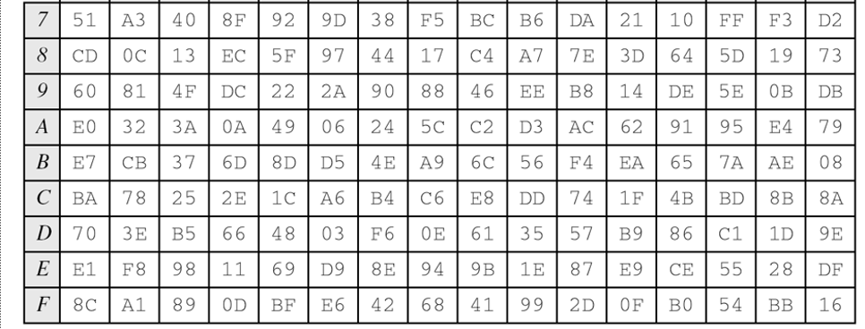
Byte transformation table

Slide 27
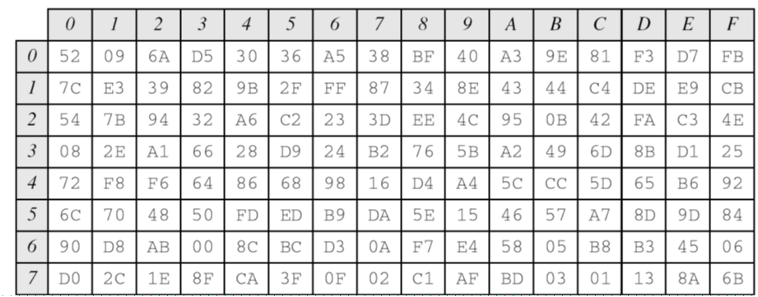
Inverse Byte transformation table

Slide 28
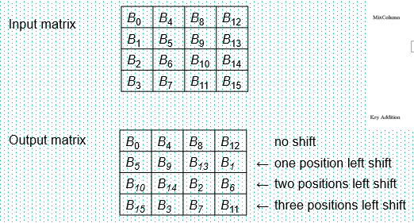
Continue
Diffusion Layer: Shift Row
₂₅ | ₂₅ | ₂₅ | ₂₅
₂₅ | ₂₅ | ₂₅ | ₂₅
₂₅ | ₂₅ | ₂₅ | ₂₅
₂₅ | ₂₅ | ₂₅ | ₂₅
₂₅ | ₂₅ | ₂₅ | ₂₅
₂₅ | ₂₅ | ₂₅ | ₂₅
₂₅ | ₂₅ | ₂₅ | ₂₅
₂₅ | ₂₅ | ₂₅ | ₂₅
Input
Output

Slide 29

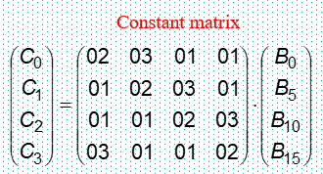

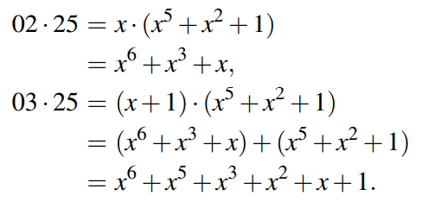
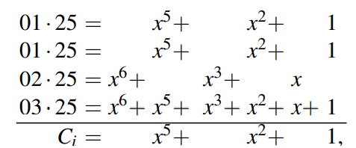
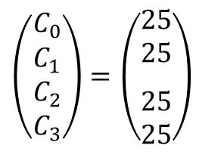
Continue
Diffusion Layer: Mix Column
$$\left(\begin{matrix}C_{0} \\ C_{1} \\ C_{2} \\ C_{3}\end{matrix}\right)=\left(\begin{matrix}\begin{aligned}25 \\ 25\end{aligned} \\ \\ 25 \\ 25\end{matrix}\right)$$
Explanation:
02 means 0000 0010= x
03 means 0000 0011= x+1
where i = 0,...,15. This leads to the output state C = (25,25,...,25)

Slide 30
Key Addition Layer
Inputs:
16-byte state matrix C
16-byte subkey k_{i}
Output: C ⊕ k_{i}
The subkeys are generated in the key schedule

Slide 31
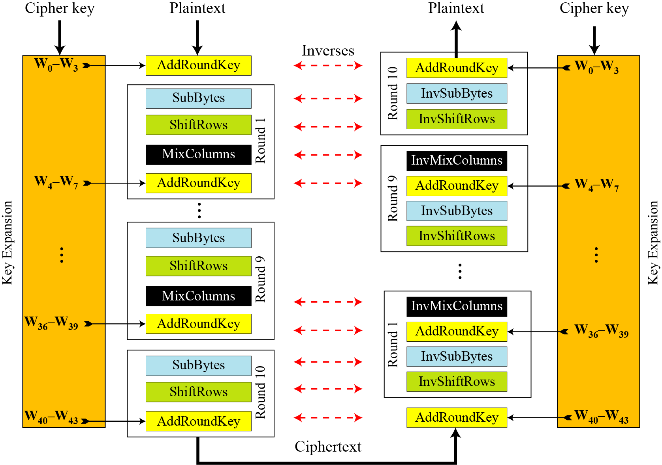
AES Encryption and Decryption Process
Key
Key

Slide 32
Key Expansion Process
Subkeys are derived recursively from the original 128/192/256-bit input key
Each round has 1 subkey, plus 1 subkey at the beginning of AES
Key whitening: Subkey is used both at the input and output of AES ⇒ # subkeys = # rounds + 1
There are different key schedules for the different key sizes
Key length (bits) | Number of subkeys
128 | 11
192 | 13
256 | 15

Slide 33
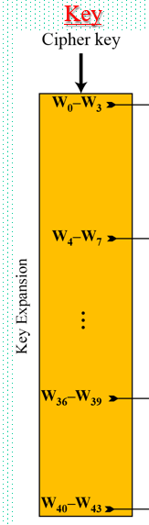
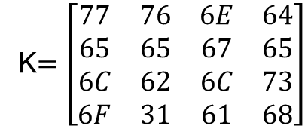
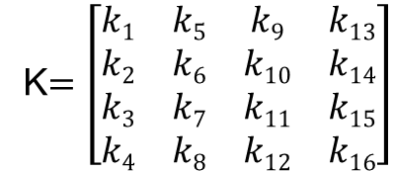
Key Expansion Process with example
Let us consider the key is: welovebangladesh
Corresponding Binary:
01110111 01100101 01101100 01101111 01110110 01100101 01100010 01100001 01101110 01100111 01101100 01100001 01100100 01100101 01110011 01101000
Hex Value: 77 65 6C 6F 76 65 62 61 6E 67 6C 61 64 65 73 68
k₁ k₂ k₃ k₄ k₅ k₆ k₇ k₈ k₉ k₁₀ k₁₁ k₁₂ k₁₃ k₁₄ k₁₅ k₁₆
Now convert it 4 x 4 matrix
K$=\left[\begin{matrix}k1 & k5 & k9 & k13 \\ k2 & k6 & k10 & k14 \\ k3 & k7 & k11 & k15 \\ k4 & k8 & k12 & k16\end{matrix}\right]$
K$=\left[\begin{matrix}77 & 76 & 6E & 64 \\ 65 & 65 & 67 & 65 \\ 6C & 62 & 6C & 73 \\ 6F & 31 & 61 & 68\end{matrix}\right]$
W0 W1 W2 W3

Slide 34
Sub Key generation process
Round 0 Key
W0 | W1 | W2 | W3
G
⊕
⊕
⊕
⊕
Round 1 Key
W4 | W5 | W6 | W7
G
⊕
⊕
⊕
⊕
Round 2 Key
W8 | W9 | W10 | W11
⁞
G
⊕
⊕
⊕
⊕
Round 10 Key
W40 | W41 | W42 | W43

Slide 35
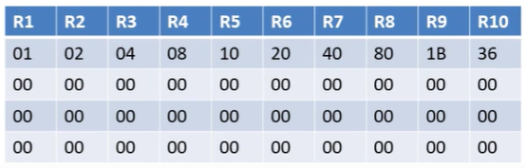
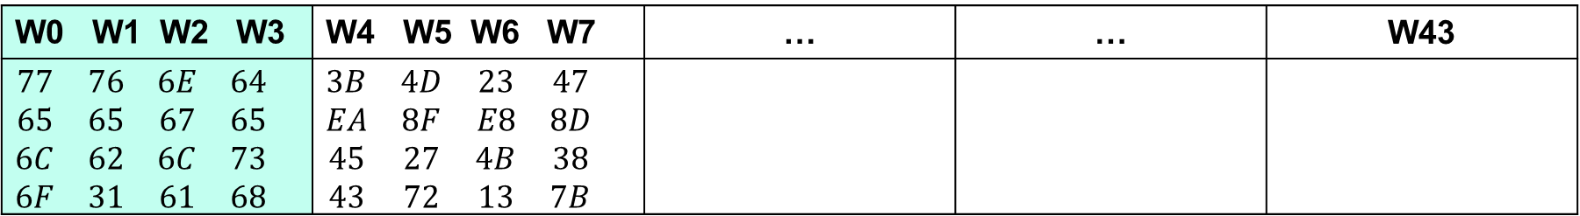
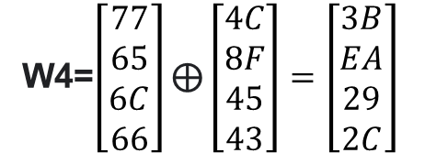
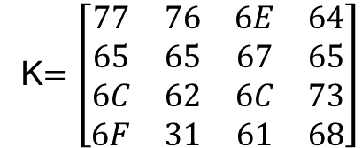

G function Calculation
Key Expansion Process with example
W0 W1 W2 W3 | W4 W5 W6 W7 | … | … | W43
$$\begin{matrix}77 & 76 & 6E & 64 \\ 65 & 65 & 67 & 65 \\ 6C & 62 & 6C & 73 \\ 6F & 31 & 61 & 68\end{matrix}$$ | $$\begin{matrix}3B & 4D & 23 & 47 \\ EA & 8F & E8 & 8D \\ 45 & 27 & 4B & 38 \\ 43 & 72 & 13 & 7B\end{matrix}$$
Step 1: Performs a one byte left shift
W3= 64 65 73 68 ➔ RotWord= 65 73 68 64
W0 W1 W2 W3
Step 2: performs a byte-wise
S-Box substitution
RotWord= 65 73 68 64 ➔ SubWord= 4D 8F 45 43
K$=\left[\begin{matrix}77 & 76 & 6E & 64 \\ 65 & 65 & 67 & 65 \\ 6C & 62 & 6C & 73 \\ 6F & 31 & 61 & 68\end{matrix}\right]$
Step 3: The result is XORed with
a round constant, Rcon[j]
W4= W0 ⊕ G(W3)
W4=$\left[\begin{aligned}77 \\ 65 \\ 6C \\ 66\end{aligned}\right]\text{⊕}\left[\begin{aligned}4C \\ 8F \\ 45 \\ 43\end{aligned}\right]=\left[\begin{aligned}3B \\ EA \\ 29 \\ 2C\end{aligned}\right]$
$\left[\begin{aligned}4D \\ 8F \\ 45 \\ 43\end{aligned}\right]$ ⊕ $\left[\begin{aligned}01 \\ 00 \\ 00 \\ 00\end{aligned}\right]=\left[\begin{aligned}4C \\ 8F \\ 45 \\ 43\end{aligned}\right]$
G(W3)= SubWord ⊕ R1

Slide 36
Content of this Chapter
Overview of the AES algorithm
Internal structure of AES
Byte Substitution layer
Diffusion layer
Key Addition layer
Key schedule
Decryption
Practical issues

Slide 37
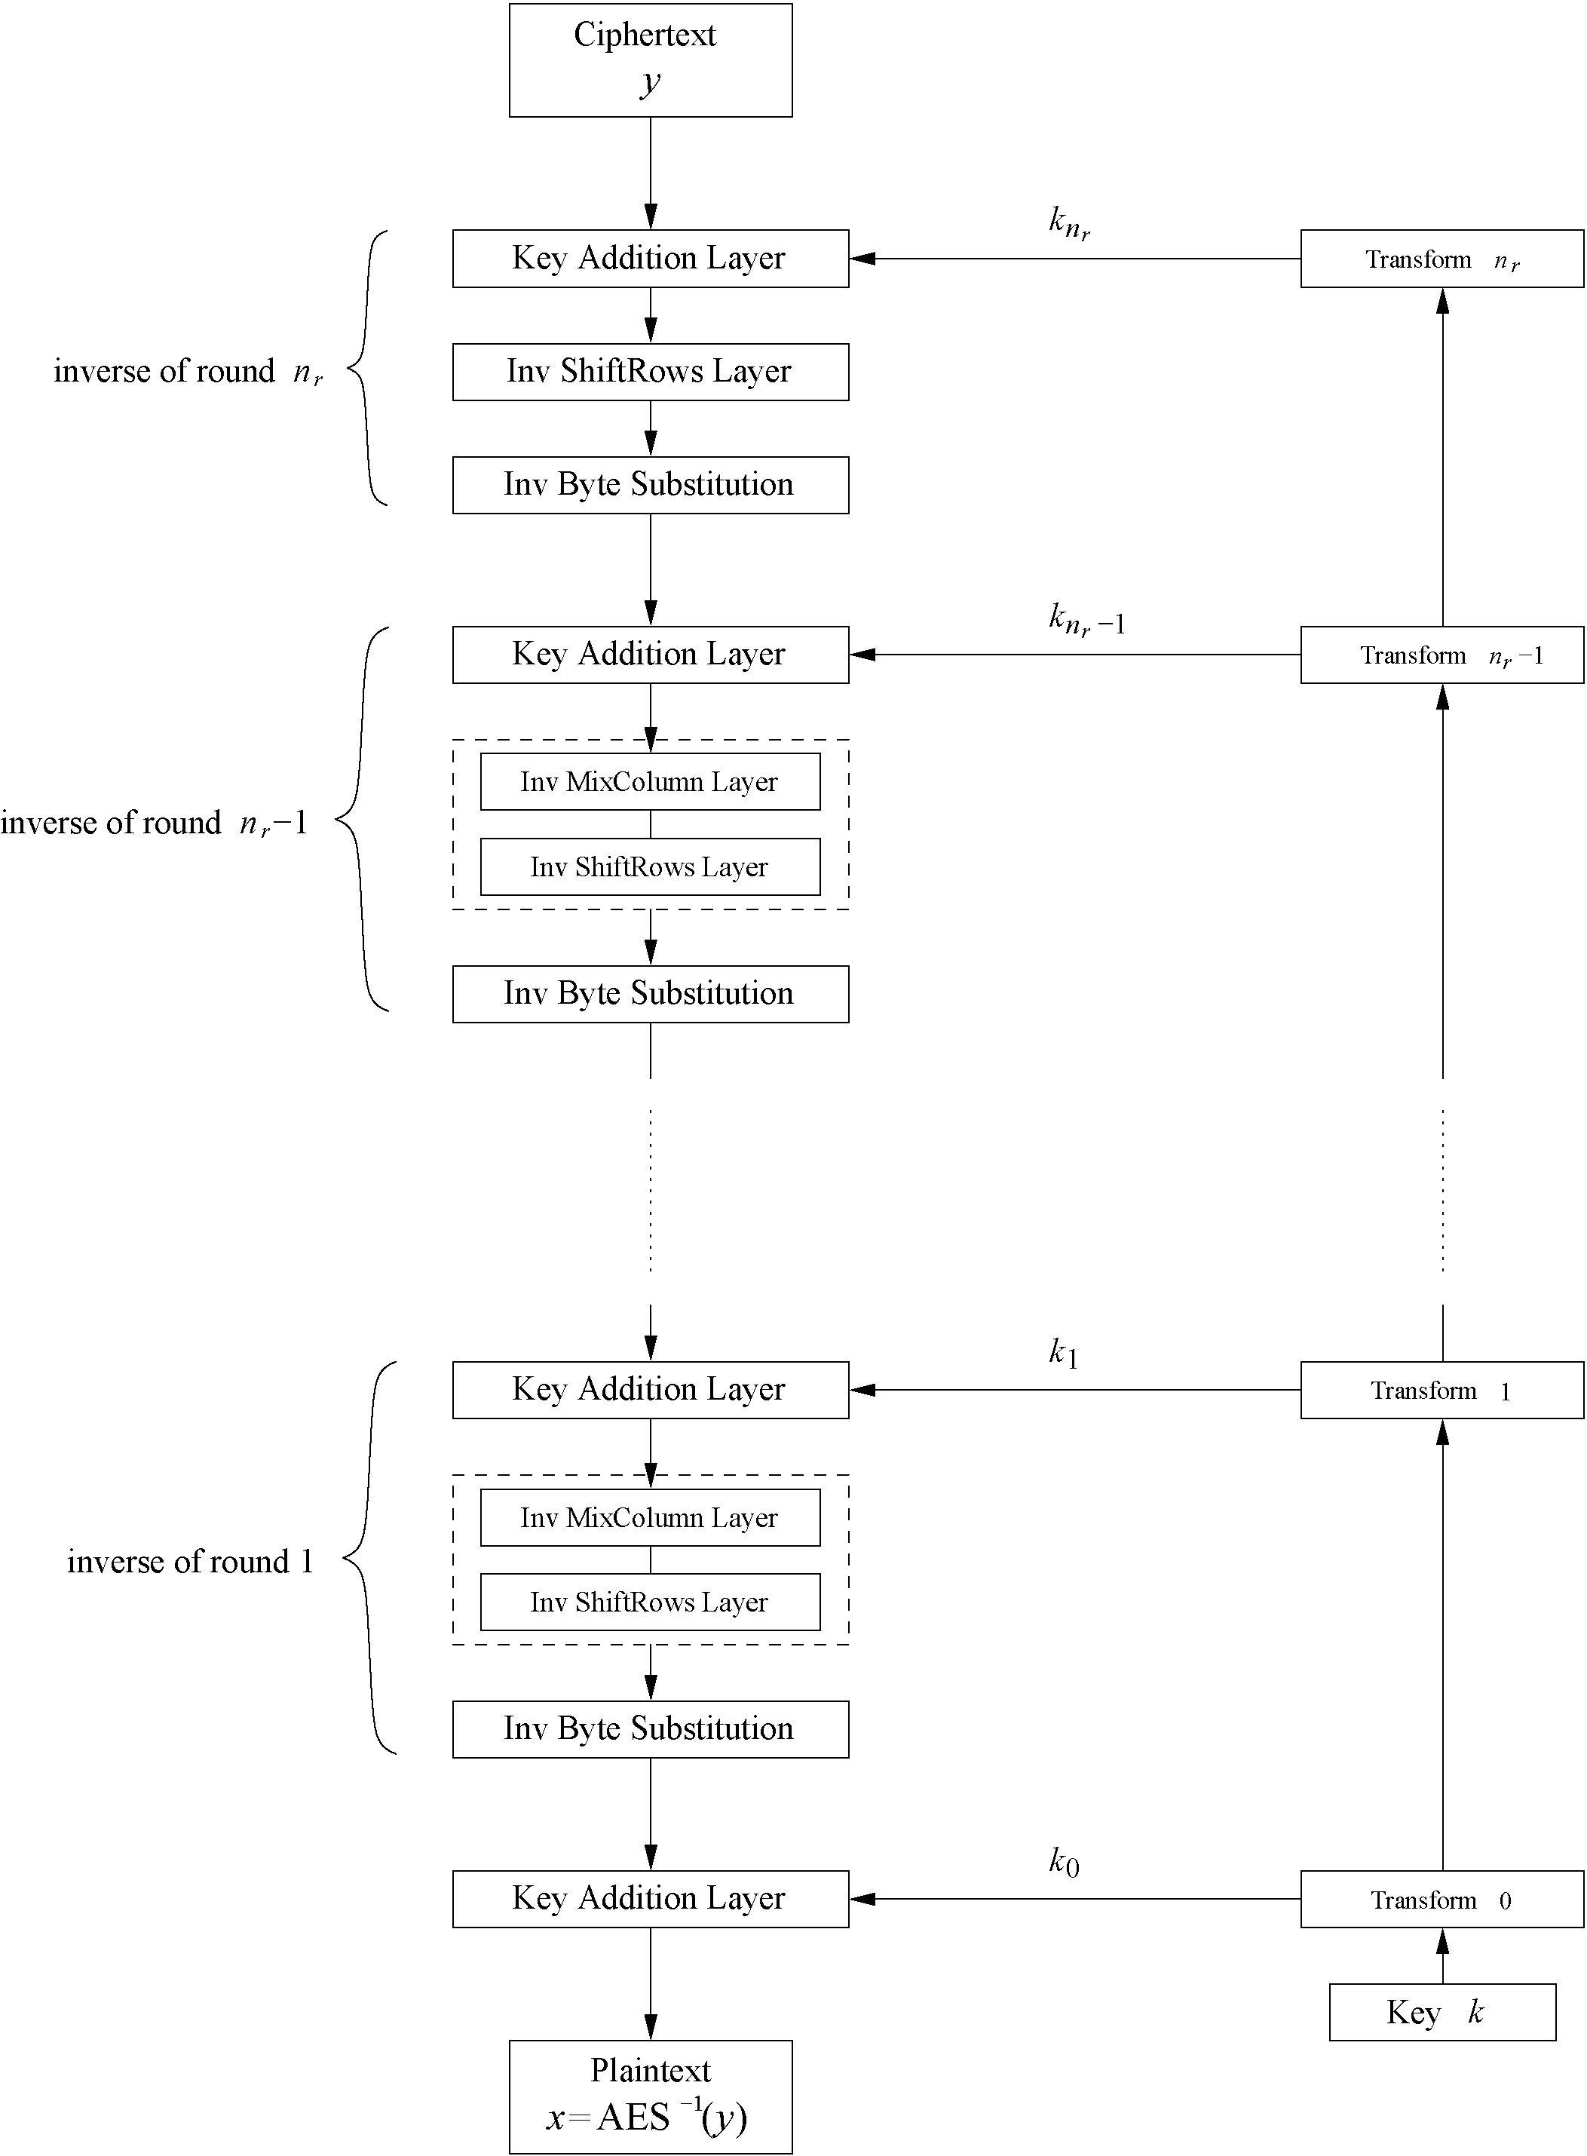
Decryption
AES is not based on a Feistel network
⇒ All layers must be inverted for decryption:
MixColumn layer → Inv MixColumn layer
ShiftRows layer→ Inv ShiftRows layer
Byte Substitution layer → Inv Byte Substitution layer
Key Addition layer is its own inverse

Slide 38
Decryption
Inv MixColumn layer:
To reverse the MixColumn operation, each column of the state matrix C must be multiplied with the inverse of the 4x4 matrix, e.g.,
where 09, 0B, 0D and 0E are given in hexadecimal notation
Again, all arithmetic is done in the Galois field GF(2⁸) (for more information see Chapter 4.3 in Understanding Cryptography)

Slide 39
Decryption
Inv ShiftRows layer:
All rows of the state matrix B are shifted to the opposite direction:
Input matrix
Output matrix
B₀ | B₄ | B₈ | B₁₂
B₁ | B₅ | B₉ | B₁₃
B₂ | B₆ | B₁₀ | B₁₄
B₃ | B₇ | B₁₁ | B₁₅
B₀ | B₄ | B₈ | B₁₂
B₁₃ | B₁ | B₅ | B₉
B₁₀ | B₁₄ | B₂ | B₆
B₇ | B₁₁ | B₁₅ | B₃
no shift
→ one position right shift
→ two positions right shift
→ three positions right shift

Slide 40
Decryption
Inv Byte Substitution layer:
Since the S-Box is bijective, it is possible to construct an inverse, such that
A_{i} = S⁻¹(B_{i}) = S⁻¹(S(A_{i}))
⇒ The inverse S-Box is used for decryption. It is usually realized as a lookup table
Decryption key schedule:
Subkeys are needed in reversed order (compared to encryption)
In practice, for encryption and decryption, the same key schedule is used. This requires that all subkeys must be computed before the encryption of the first block can begin

Slide 41
Content of this Chapter
Overview of the AES algorithm
Internal structure of AES
Byte Substitution layer
Diffusion layer
Key Addition layer
Key schedule
Decryption
Practical issues

Slide 42
Implementation in Software
One requirement of AES was the possibility of an efficient software implementation
Straightforward implementation is well suited for 8-bit processors (e.g., smart cards), but inefficient on 32-bit or 64-bit processors
A more sophisticated approach: Merge all round functions (except the key addition) into one table look-up
This results in four tables with 256 entries, where each entry is 32 bits wide
One round can be computed with 16 table look-ups
Typical SW speeds are more than 1.6 Gbit/s on modern 64-bit processors

Slide 43
Security
Brute-force attack: Due to the key length of 128, 192 or 256 bits, a brute-force attack is not possible
Analytical attacks: There is no analytical attack known that is better than brute-force
Side-channel attacks:
Several side-channel attacks have been published
Note that side-channel attacks do not attack the underlying algorithm but the implementation of it

